Slide 1
UI Design
Software Engineering
Group: Nerd Herd

Slide 2
Introduction
Our App
Runs on Android
Inventory management system
Fills an existing software gap
Configurable for a wide range of applications
General use cases stemming from our SRS
Retrieve item information (scan)
Add, edit, delete item
Search/sort/filter inventory
Application configuration (fields, categories)
System administration (permissions, users)
Generate reports
Our UI Goals
Simple, easy to use, consistent, and intuitive
Efficiency and usability
Match the experience to the user
Clear input/output responsibilities

Slide 3
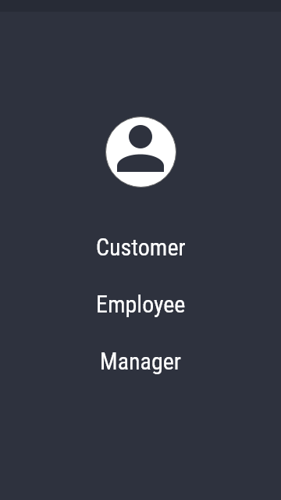
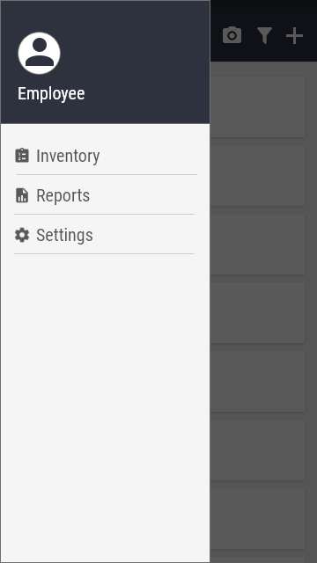
Login and Navigation
Notes:
The first image is the login screen, which contains the different user types we have. Different user types have different permissions. Upon clicking on any of them, the will go to the inventory listing. The other image is the navigation drawer. It is not a separate screen but a view a user can open in any screen by swiping the left side of the screen. This basically navigates the user to the different “main” pages in the app.

Slide 4
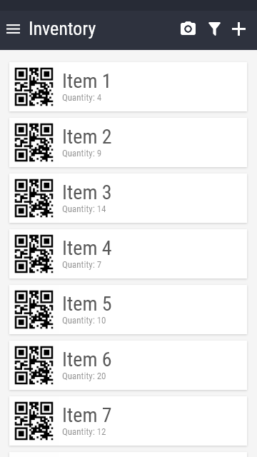
Inventory and Item Views

Slide 5
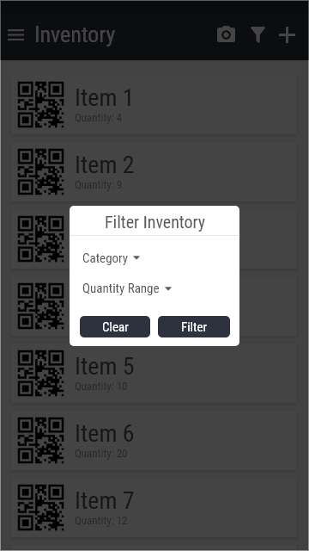
Inventory and Item Views

Slide 6
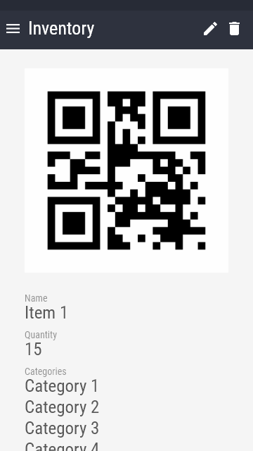
Inventory and Item Views

Slide 7
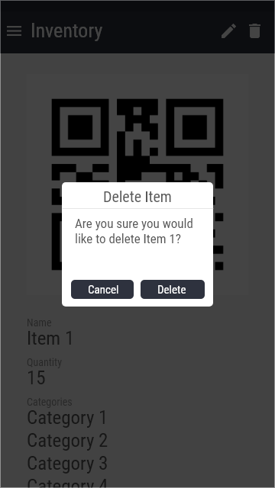
Inventory and Item Views

Slide 8
Inventory and Item Views

Slide 9
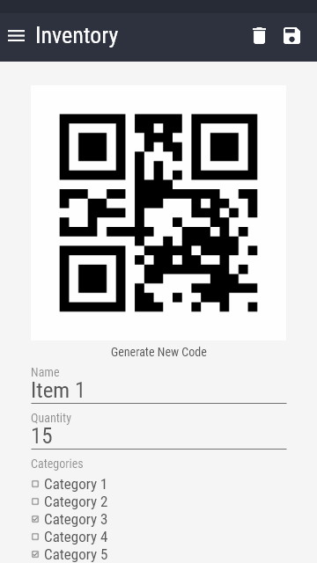
Item manipulation tasks and Customization

Slide 10
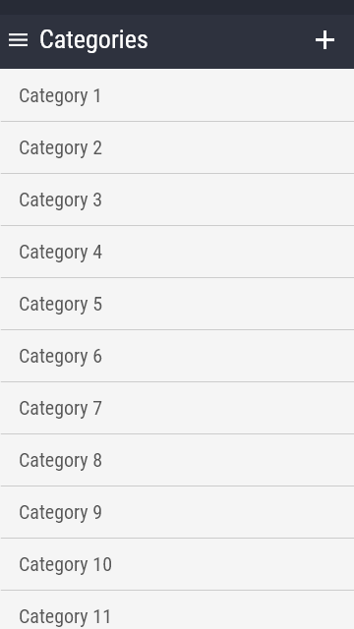
Item manipulation tasks and Customization

Slide 11
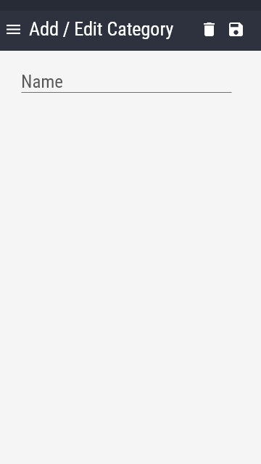
Item manipulation tasks and Customization

Slide 12
Item manipulation tasks and Customization
Notes:
One key characteristic of our app is modularity.
Whether you are a warehouse manager, small shop owner, or an office administrator, you have items that you need to keep track of.
Our inventory management system was designed with this in mind.
There is no way we could come up with every possible way of sorting and categorizing items that a customer could want, so we gave the power to the users.

Slide 13
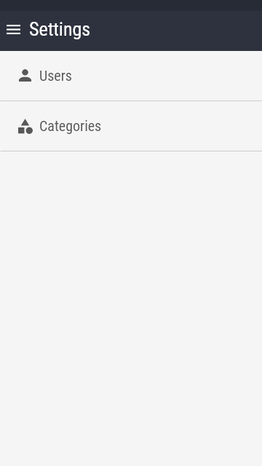
Item manipulation tasks and Customization
Notes:
From the settings menu, the admin can select the categories option to bring up the categories page.
Once on the categories screen, you are able to view all current categories, as well as add new ones by clicking the plus sign in the top right corner, which will bring up this screen.

Slide 14
Item manipulation tasks and Customization
Notes:
Here they can edit or delete old categories as well as save new categories.
These categories can also be seen on each item’s page.

Slide 15
Item manipulation tasks and Customization
Notes:
From the item page, users with the proper permissions are able to select which categories the item would be classified under by simply clicking the checkbox next to the corresponding categories.
Once they are done making changes, they can hit the save button and the app will update the item’s categorizations.

Slide 16
Settings, Admin functions, and reports
Notes:
Here is the page for admin access only. They will be able to look at all the users and categories that have been added to the system. Other settings can be added later such as a store restriction setting for when a store locator is added to the application. Restriction would limit the stores in which someone can purchase any item to only approved vendors. In any case, lets first well look at the Users page.

Slide 17
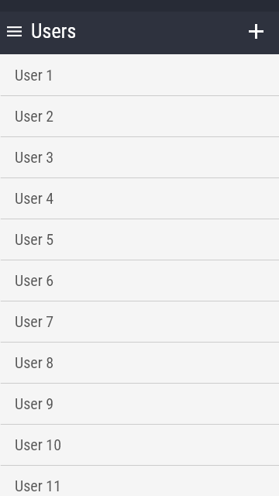
Settings, Admin functions, and reports
Notes:
So here we will be able to look at all the users. Here the admin will have access to all the user profile and assign whatever permissions an admin may think that a user will need. Like a group or what items a user can have access to. If you click a user,

Slide 18
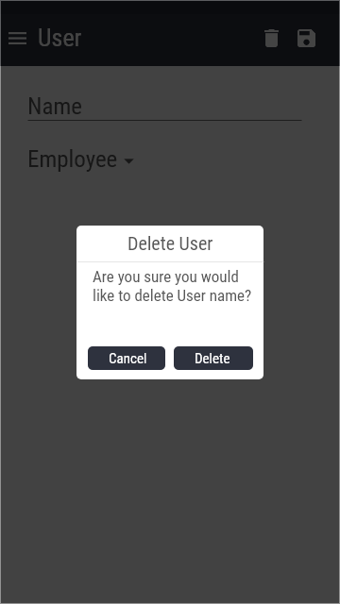
Settings, Admin functions, and reports
Notes:
The information related to them pops up like you see here behind the delete user pop up. Here the admin can choose to delete any user which will prompt this confirmation alert as can be seen here.

Slide 19
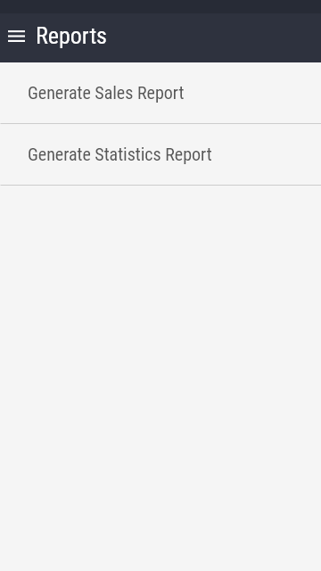
Settings, Admin functions, and reports
Notes:
Another function which the admin will have will be the ability to generate a sales or statistics report. Here you can see the two report options. It is still kind of undecided as to how the report will be generated. Options are varied and include a heat map which will show the most used to least used items in the database or say a numeric report that shows usage in percentage values. Sales would be a prediction of usage based on statistics. The report will be generated in the desired format and displayed on screen with options to save it somewhere.

Slide 20
Settings, Admin functions, and reports

Slide 21
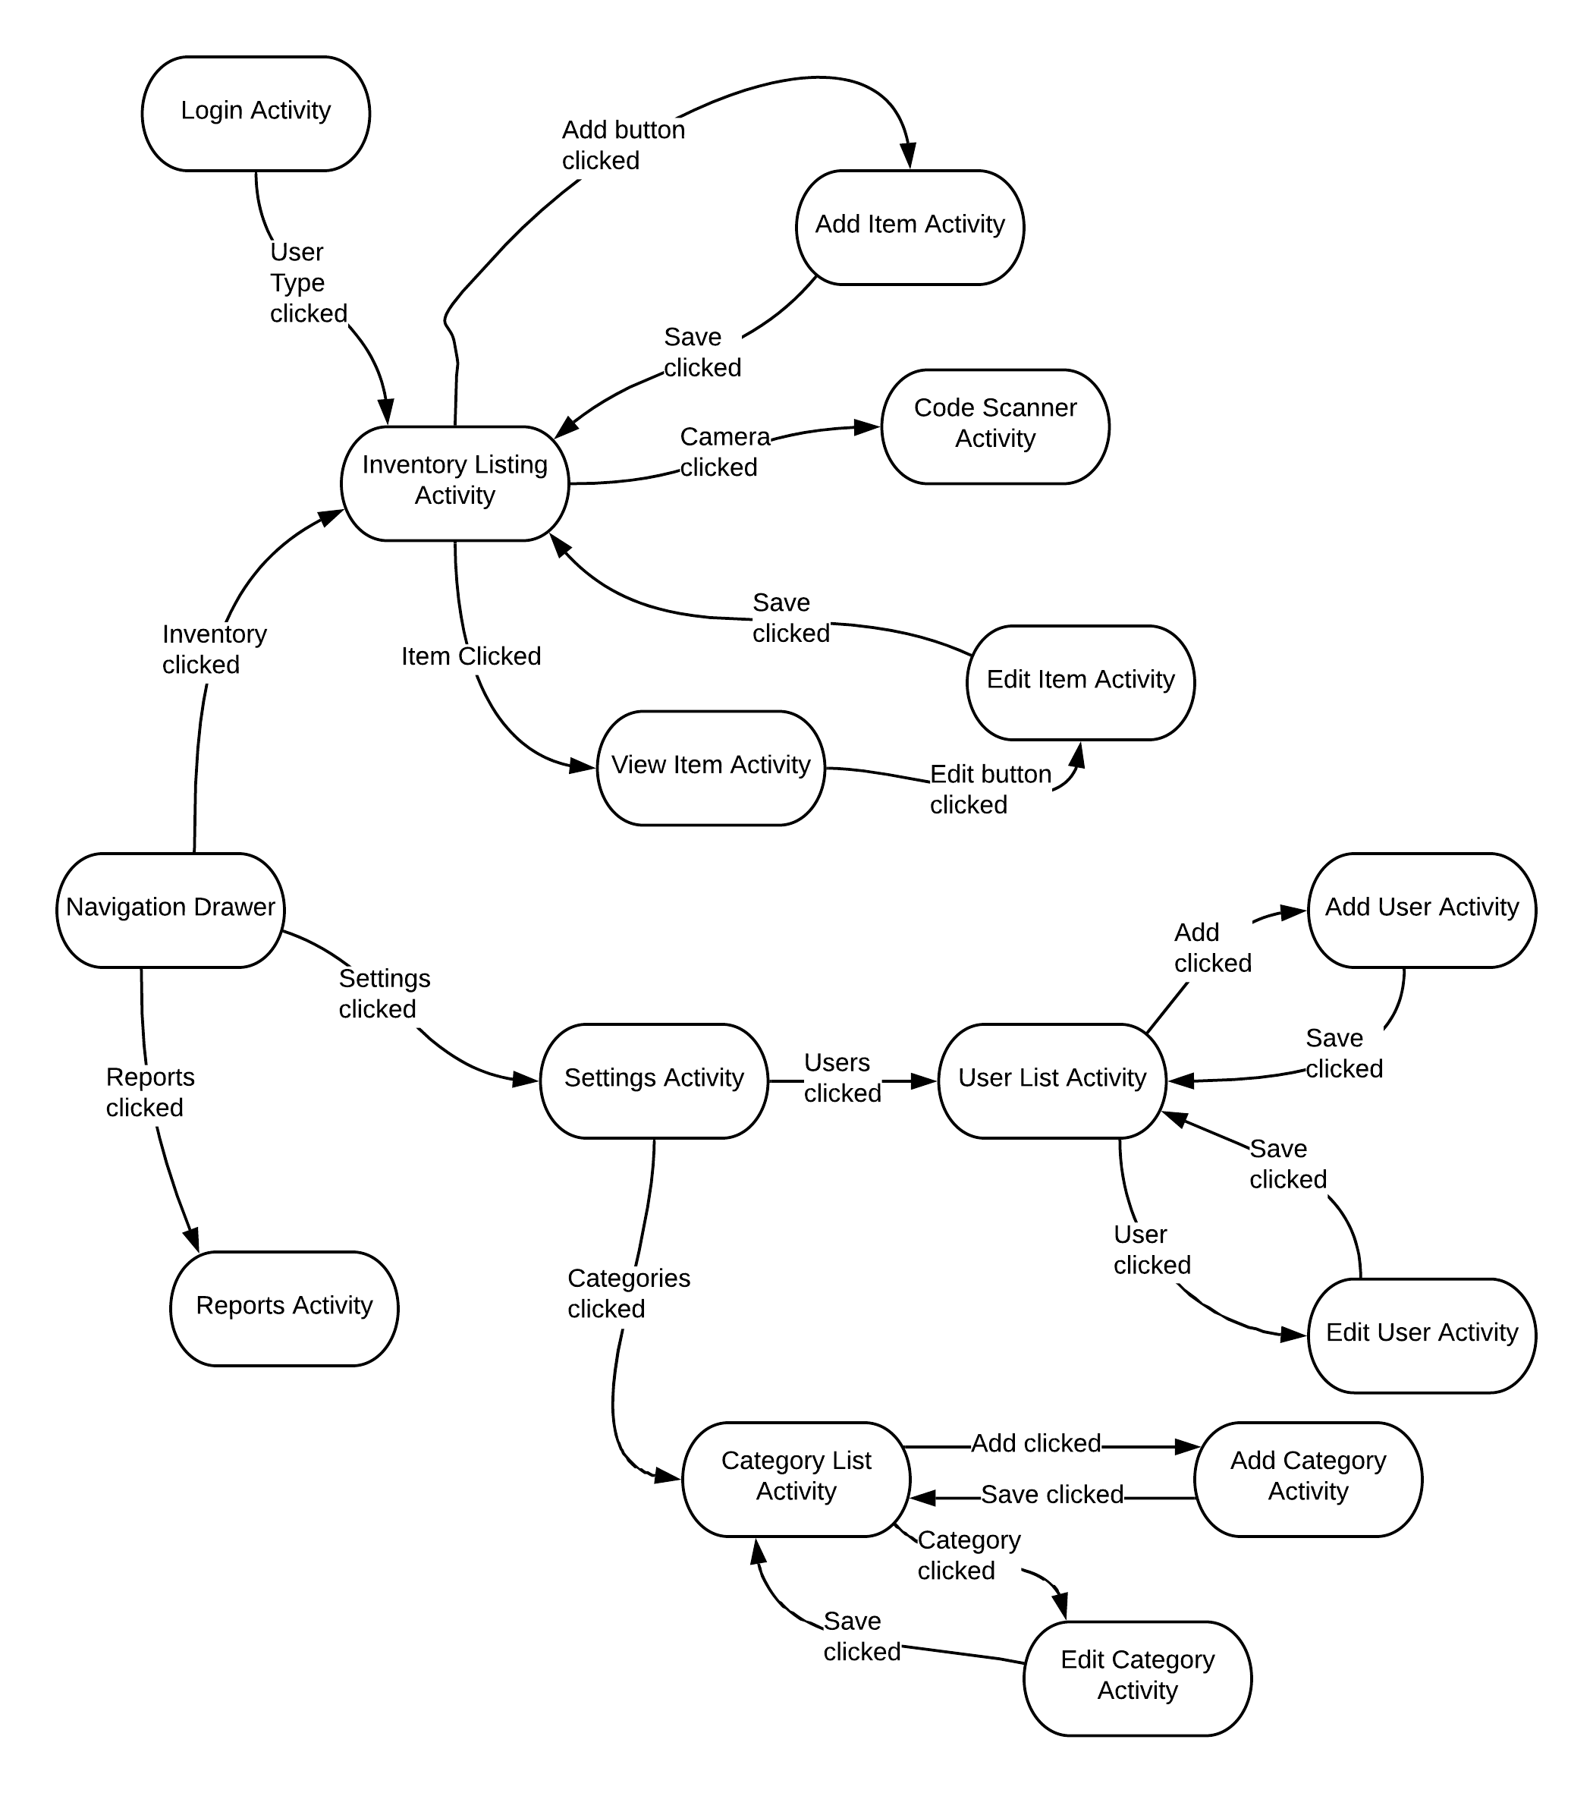
Transitions Diagram and Conclusion
Notes:
we learned more details regarding the implementation of the application, especially which specific elements will take a user from the current screen to another specific screen (so implementation of the navigation).

